Slide 1
Adams 12 Five Star Schools Sustainability Endeavors
Shannon Oliver
Manager, Energy & Sustainability
Adams 12 Five Star Schools
October 31, 2019

Slide 2
2018-2019 Utilities Performance Benchmark
Parameter | Period | Performance | Percent Change
Electricity Use (kWh/yr) | 3-yr Baseline | 38,131,315 | 7.81%
 | FY 2018-2019 | 41,362,538
Natural Gas Use (therm/yr) | 3-yr Baseline | 1,638,595 | 4.10%
 | FY 2018-2019 | 1,708,719
Energy Use Intensity (kBtu/sq. ft.) | 3-yr Baseline | 65.2 | 5.15%
 | FY 2018-2019 | 68.7
Renewable Energy Offset (%) | 3-yr Baseline | 5.7% | 12.28%
 | FY 2018-2019 | 6.4%
Bus Fleet Fuel Efficiency (gal/VMT) | 3-yr Baseline | 5.4 | -2.06%
 | FY 2017-2018 | 5.3
Indoor Water Use² (kGal/yr) | 3-yr Baseline | 39,758.1 | 1.91%
 | 2018 | 40,530.4
Total Water Use² (kGal/yr) | 3-yr Baseline | 224,622 | -23.59%
 | 2018 | 181,751
Student Engagement (# Green Teams) | FY 2016-2017 | 29 | -38.10%
 | FY 2018-2019 | 21
Waste Diversion Rate (%) | FY 2016-2017 | 16.9% | 10.82%
 | FY 2018-2019 | 19.0%
² Total Water Use Benchmark based on calendar year due to watering season.

Slide 3
2018-2019 Utilities Cost Benchmark

Slide 4
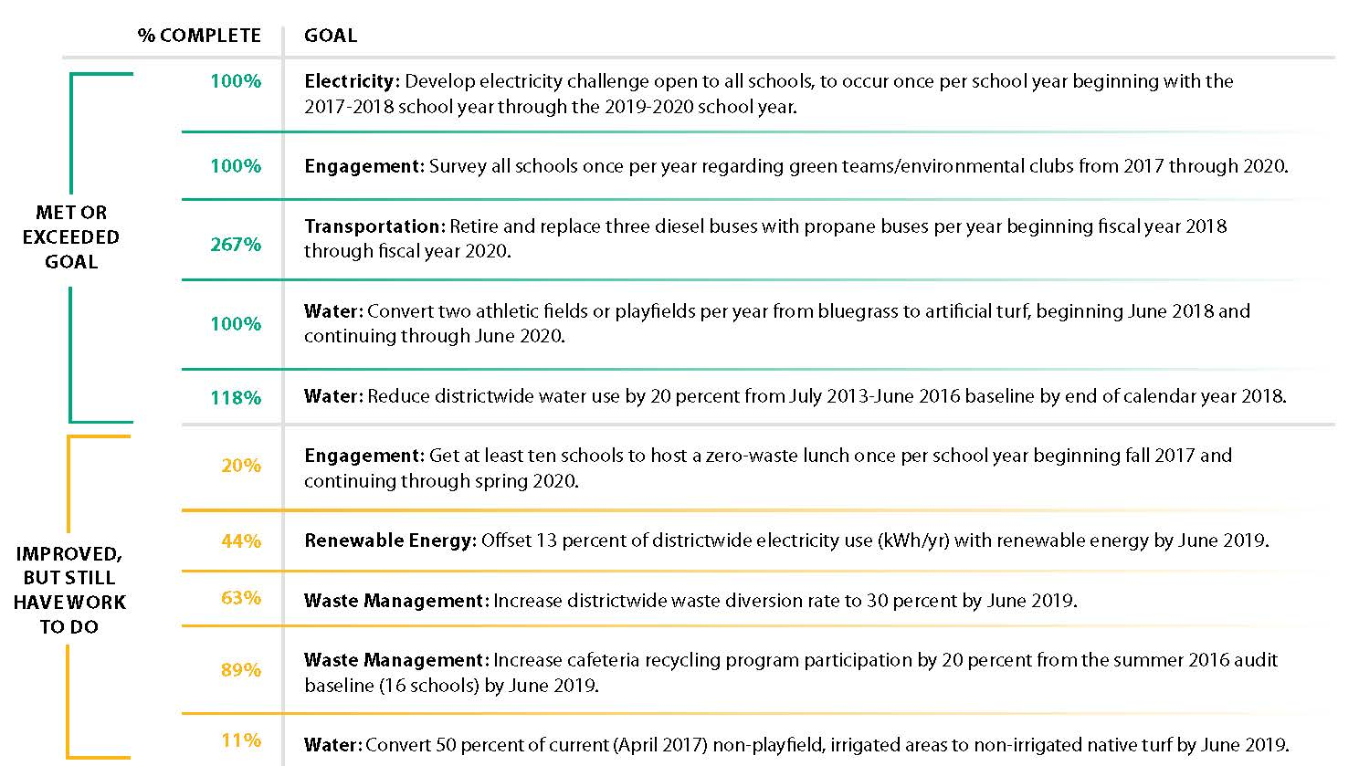
2018-2019 SMP Goals Progress

Slide 5
A Deeper Dive – Water Numbers
Water Resource Specialist Active

Slide 6
A Deeper Dive – Water Rates ($/kGal)

Slide 7
Organic Growth – Composting & Recycling Success
2015/2016 School Year
2019/2020 School Year
1 school composting
8* schools composting
*2 more in discussions
16 cafeteria recycling
programs
19 cafeteria recycling
programs
17% Diversion Rate
19% Diversion Rate

Slide 8
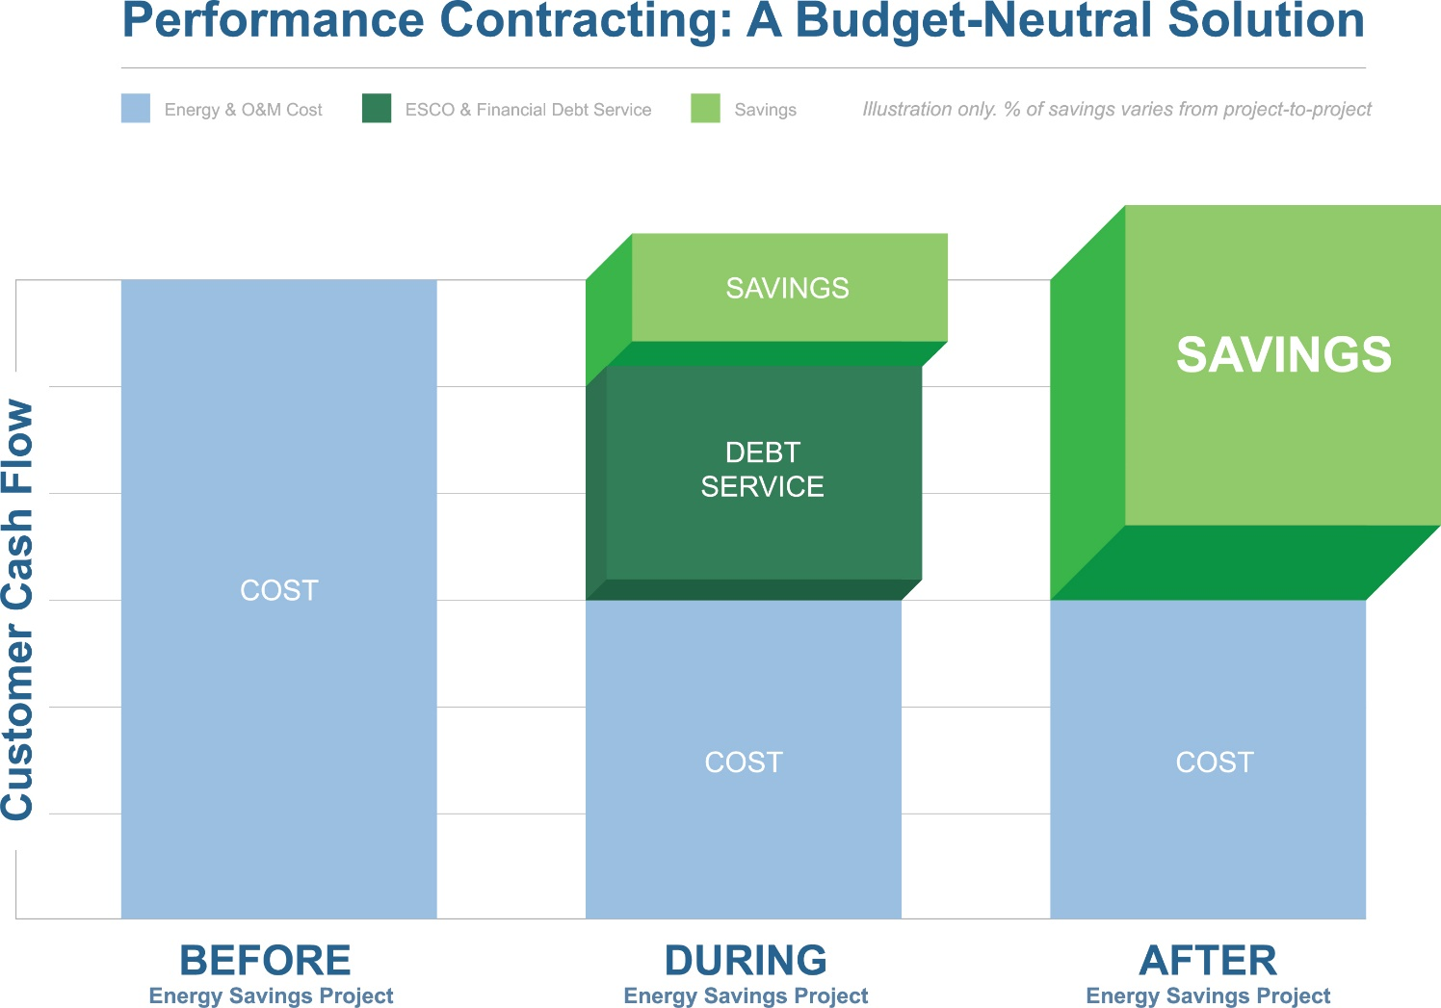
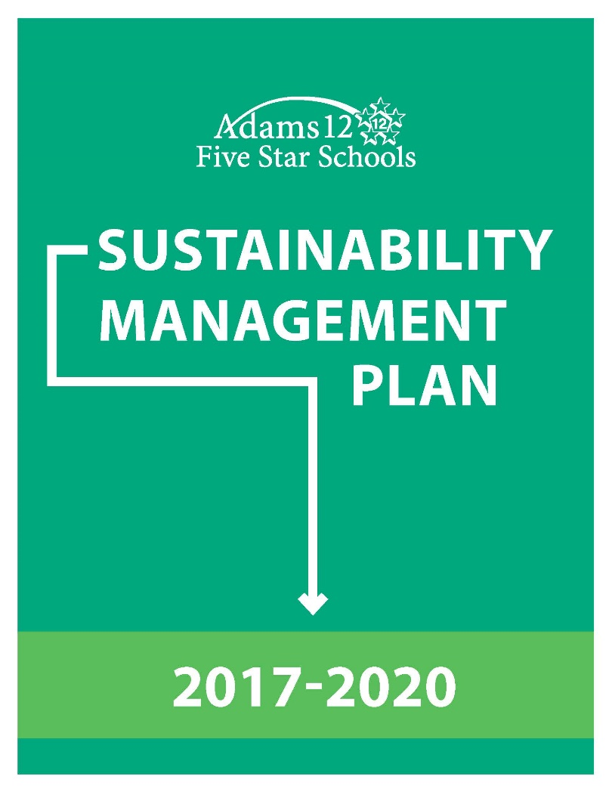
Two Big Projects for 2019/2020

Slide 9
Energy Performance Contract
Utilizing CEO process and MOU
6 vendors responded to RFP
3 vendors selected for interviews
McKinstry awarded IGA contract
60% Design meeting in early Dec
Final design early 2020
Construction summer 2020
8 elementary schools
Full LED upgrades
Full integration into Niagara 4 platform
Smart electricity meters
Irrigation and plumbing water efficiency
Capital HVAC work
Solar

Slide 10
Next District SMP
Current SMP wraps up June 2020
Progress under current is SMP is only 47% goals achievement
Missing components identified:
District-level Energy Policy
District-level Materials Management Plan
District-level Green Purchasing Policy
Utilizing the Continuous Improvement process
Currently interviewing students: What does sustainability mean to them?
Will interview Sr. Staff as well
Framework: TBD
Focus Areas & Goals: TBD
Timeframe: TBD

Slide 11
Thanks for listening and coming to Adams 12!
QUESTIONS?

Slide 12
CASDEM Sustainability Departments
10/31/19 | Hal Corin

Slide 13
Origins of EM/Sustainability Program
When were your departments started?
Initial goal or duties?
Where is your department in the org structure?
Is anyone outside of facilities or operations?
Has anyone been successful at integrating sustainability into curriculum?
Are there district level staff outside of your department that would be considered as working on sustainable topics?

Slide 14
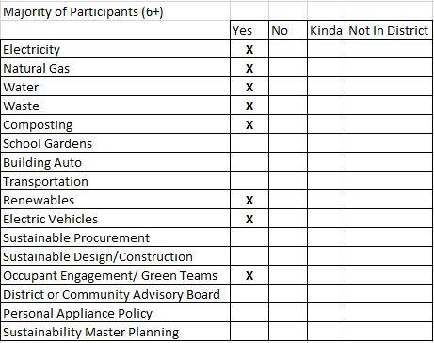
Majority Scoring

Slide 15
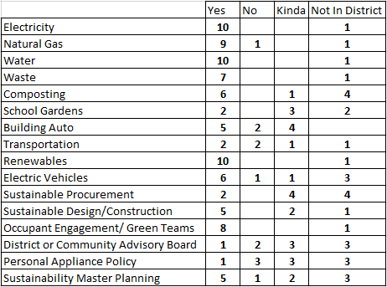
RESULTS
Eleven Respondents
Outliers
Core responsibilities: Electricity, Natural Gas, Water, Renewables
10/11 have Renewables!
6 have EVs and Composting
5 w/ Sustainable Construction, Building Auto, and SMPs
2 w/ Gardens, Transportation, Sustainable Procurement

Slide 16
QUESTIONS FOR THE FEW
Who has the District/Community Advisory Board?
Who is responsible for SMP and where are you in the process?
What level of support for EVs and what’s next?
What related policies have been implemented?
Is composting supported at sites or done district wide?
What has been accomplished in sustainable procurement?
What is the DW Appliance Policy like?
What barriers do others see in adoption?

Slide 17
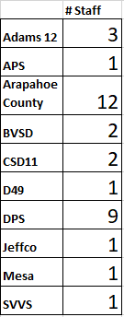
Districts with 1 on staff, what’s the first position you would hire?
Are any positions grant funded?
Staffs w/ 2-3, what is your division of labor?
DPS and Arapahoe Co?

Slide 18
Districts that check many boxes
Have these areas shifted or were they always the plan?
How have you justified new staff or creation of new positions?
In what areas are you trying to expand scope of responsibility?
What’s next?

Slide 19
Goals
Does anybody have a 100% renewable or net zero goal?
How about migration off of natural gas?
What goals do you have in place?

